Slide 1
Web Bluetooth Api

Slide 2
Overview
With BLE (low power Bluetooth), We can play with a variety of electronic equipment on the pattern.
The Web Bluetooth API is working to achieve this goal, an API based on the promise specification.
The emergence of this API is not only the benefit of the user (the phone space), but also saves the developer / publisher cost - no need for new hardware products to develop at least one independent app to control, unified with cross-platform pages On the line.

Slide 3
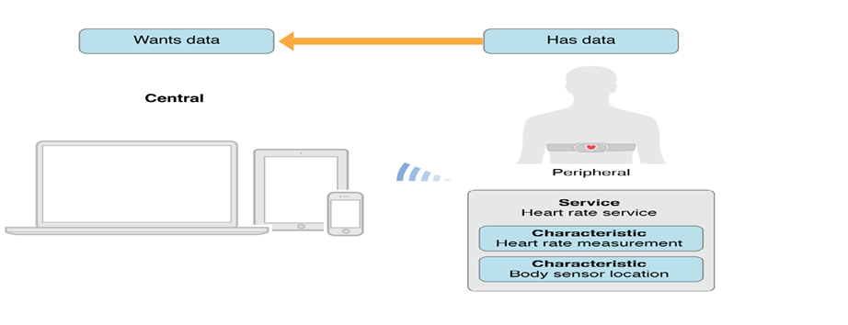

Slide 4
Web Bluetooth API
So far, in the mobile device to do BLE interaction must pass the original app. Web Bluetooth API wants to change this by making device interaction from web browser.
First you have to know:
HTTPS only
Trigger by user action

Slide 5
How to use the API?
Scan for relevant Device
Connect to it
Get the Service you are interested in
Get the Characteristic you are interested in
Read / Write / Subscribe to the characteristic

Slide 6
Get the basic information about the device
The following code ... is a button:
<button id="the-button">Try it</button>
Of course this is corresponding JS code:
const button = document.querySelector('#the-button');
button.addEventListener('click', function() {
navigator.bluetooth.requestDevice({
filters: [{
services: ['battery_service']
}]
}).then(device => {
console.log('Got device:', device.name);
console.log('id:', device.id);
});
});

Slide 7
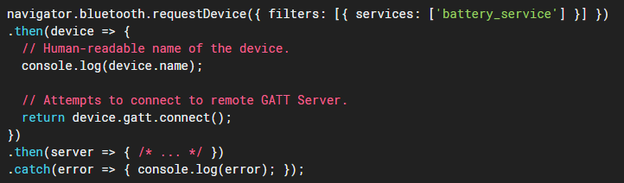
Connect to a Bluetooth Device
requestDevice() returns a promise through which we can connect to Bluetooth remote GATT Server and get its services and characteristics.

Slide 8
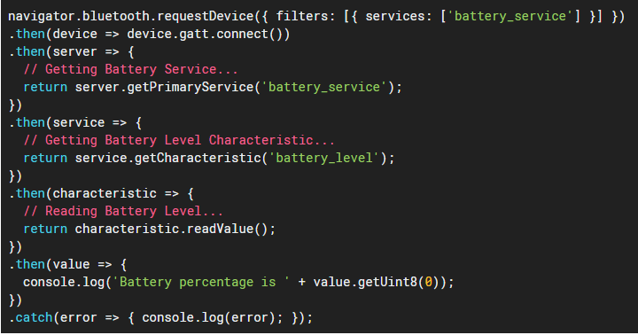
Read a Bluetooth Characteristic
Here we are connected to the GATT Server of the remote Bluetooth device.

Slide 9
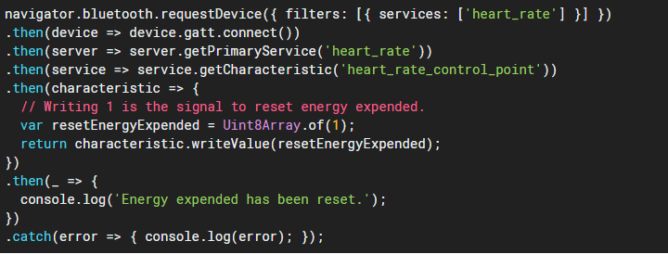
Write to a Bluetooth Characteristic
let's use the Heart Rate Control Point to reset the value of the Energy Expended field to 0 on a heart rate monitor device.

Slide 10
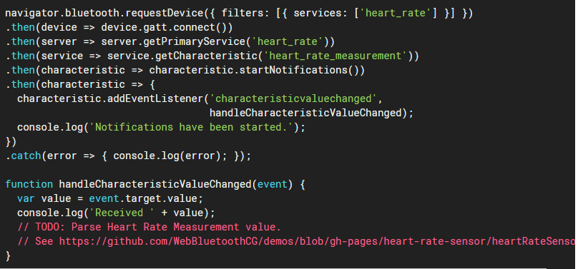
Receive GATT Notifications
We can receive notifications when characteristic value get’s changed in the device.

Slide 11
Conclusion
By this POC I have learnt about BLE devices and how to interact with these devices using Web Bluetooth Api.

